Slide 1
CHAT APP
REPRESENTED BY:(NAME)
CLLG NAME(-)

Slide 2
CONTENTS
INTRODUCTION
MODULE AND DESCRIPTION
HARDWARE AND SOFTWARE SPECIFICATION
FRONT END AND BACK END
DFD
SCREENSHOTS
CONCLUSION

Slide 3
INTRODUCTION OUR project is an example of chat application which is basically based on public chatting (message is broadcast to all connected users) It is made of two application Clint application which runs on user’s Pc To start chatting client should get connected to server.

Slide 4
MODULES
SERVER MODULES:-
A server is a specially equipped computer connected to the
Internet that allows users with chat clients to converse with
one another via typed messages in real time.
CLIENT MODULES:-
A client is a software program that allows users to connect
to chat services and communicate with other users via a chat room.

Slide 5
HARDWARE SPECIFICATION
RAM -2 GB
HARD DISK-5 GB
PROCESSOR-INTEL PENTIUM 4
KEYBOARD -104 KEYS

Slide 6
SOFTWARE REQUIREMENT
JDK 1.8_20
JRE 8
WINDOWS 7
ORACLE 10g
NETBEANS 7.4

Slide 7
FRONT END
JAVA
HTML

Slide 8
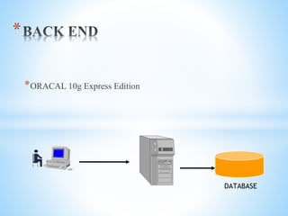
BACK END
ORACLE 10 g Express Edition

Slide 9
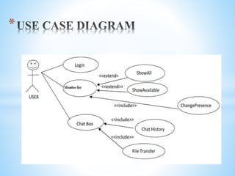
DATA FLOW DIAGRAM

Slide 10
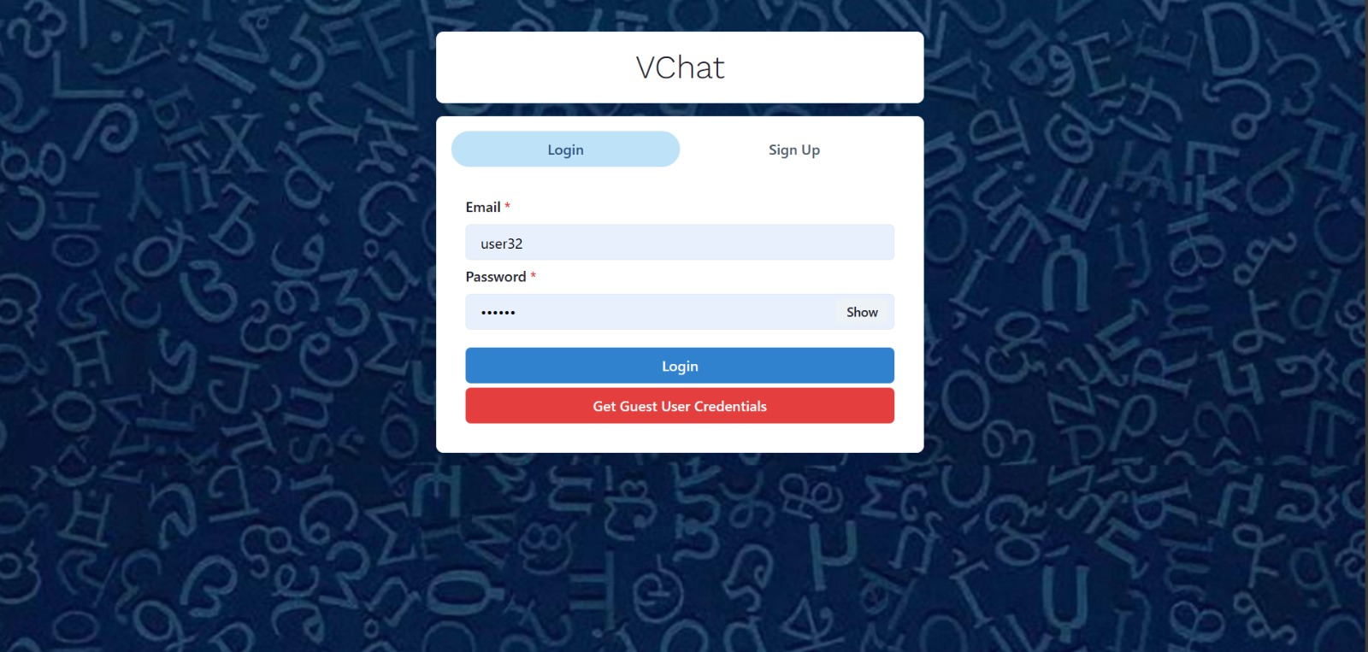
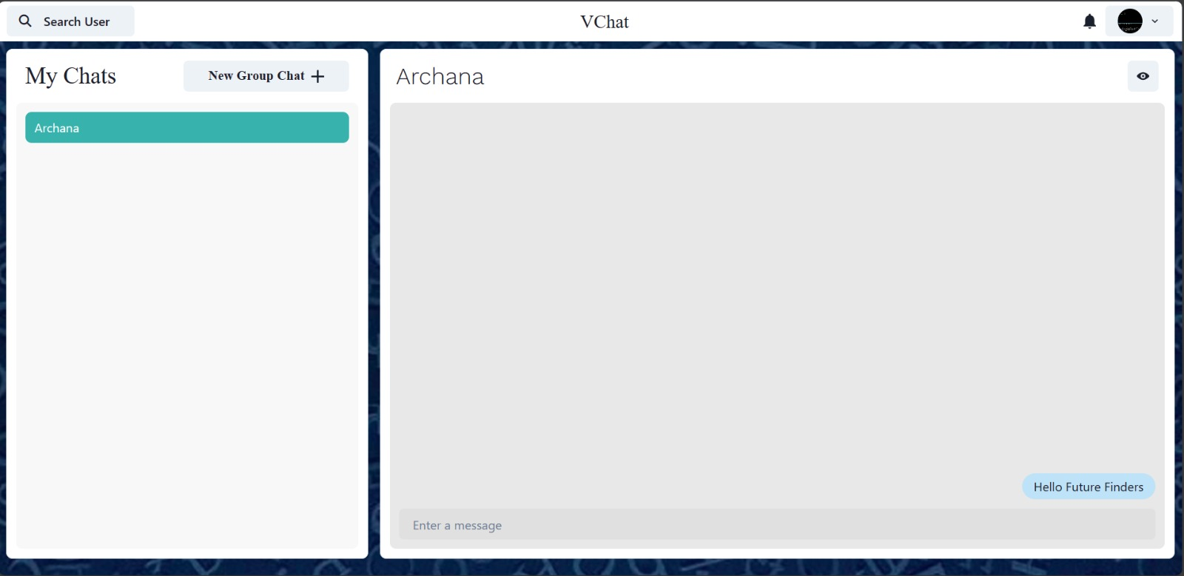
SCREENSHOTS

Slide 11
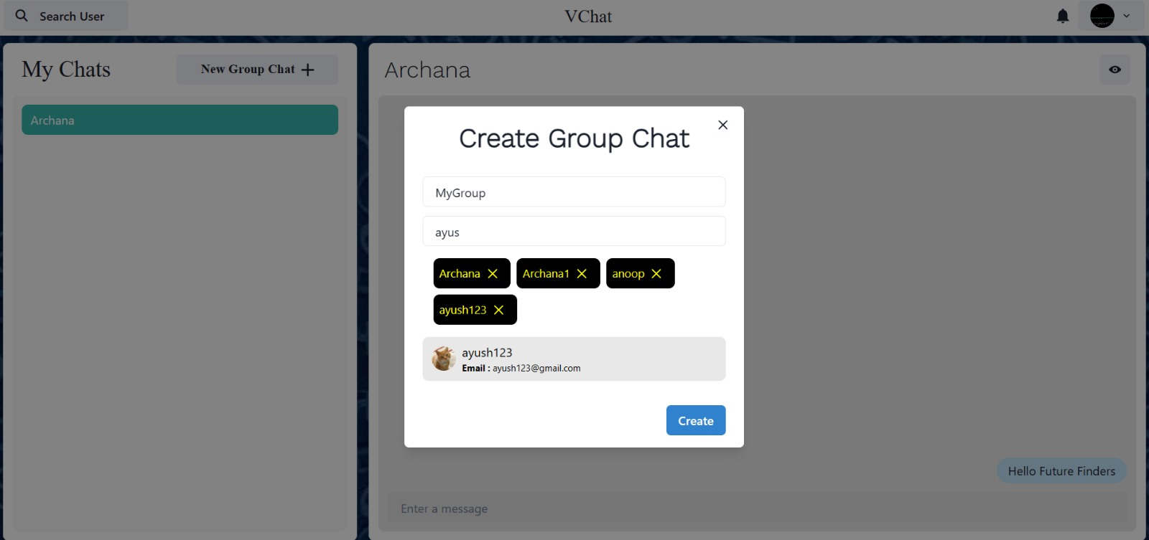
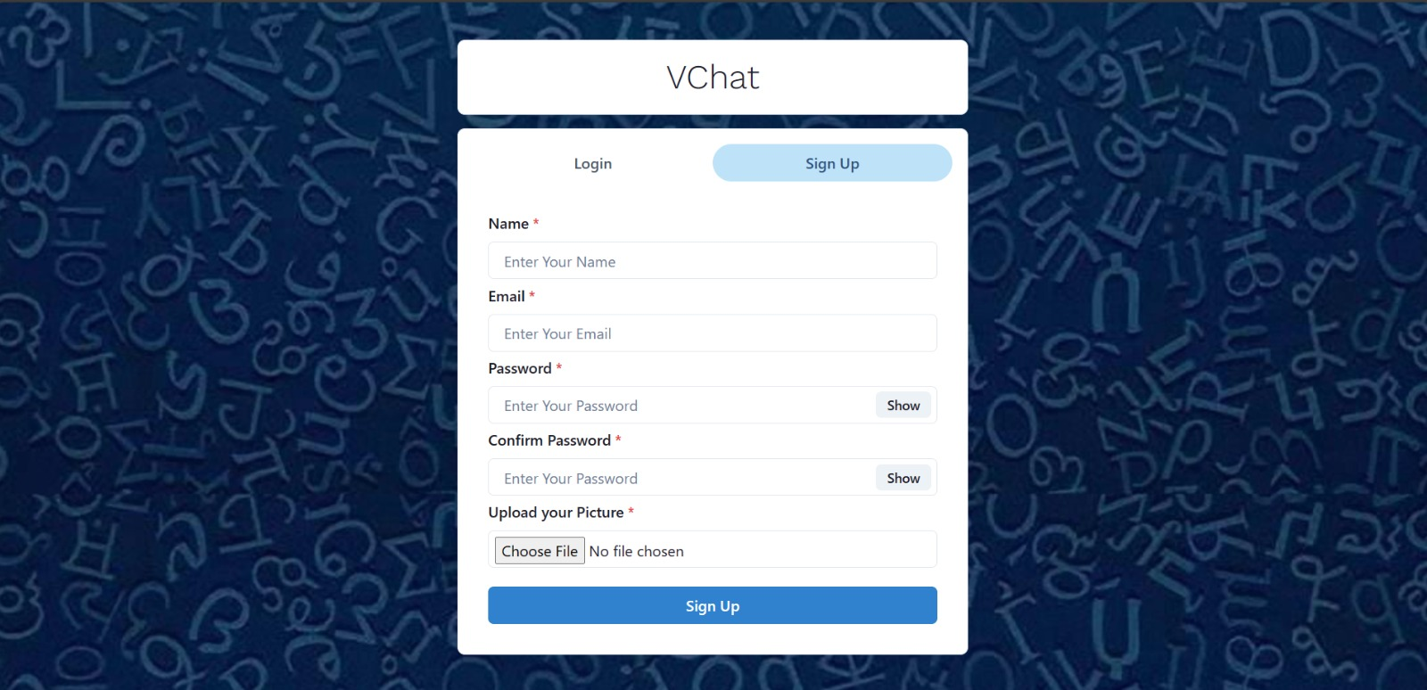
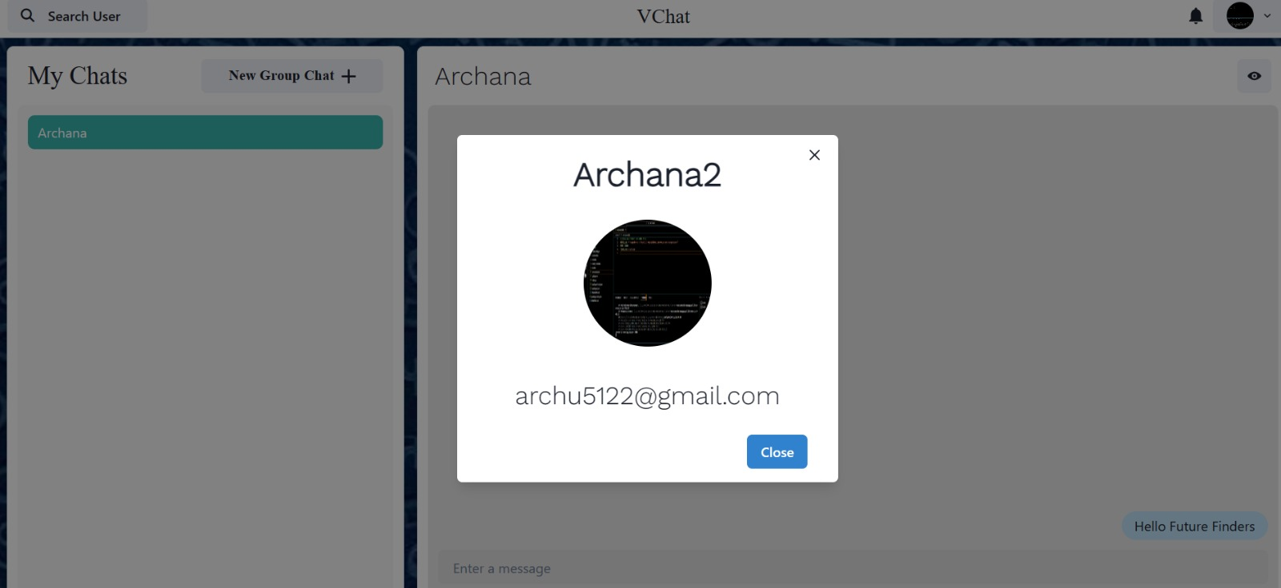

Slide 12
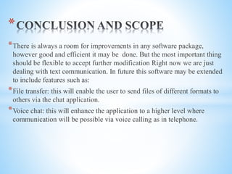
CONCLUSION

